Slide 1


WELCOME

Slide 2
Yoga is a gift bestowed to the world by India. Today’s uncertain world, lifestyle, increasing levels of stress, junk food have therefore enhanced the need for practicing Yoga.
In order to maintain a healthy lifestyle it has become utmost important for everyone to practice Yoga in a proper scientific way. Considering this need of the society Yogguru DEEPAKJI along with Gurumauli VAISHALIJI have initiated Bramhamuhurta Yoga Dnyanpeeth Kendra (BYDK) in the year 2015 (5th August).
BYDK has understood the importance of Bramha Muhurta (4:00am-6:00am). Bramha Muhurta is an auspicious time of the day when the energy is at its peak and in abundance. BYDK tries to capitalize the use of this abundance energy.

Slide 3
BYDK was formed 4 years ago and has successfully conducted 20 Shibirs in the past 3 years and is constantly marching ahead to improve the life of millions in future. During this journey BYDK has successfully trained about 20,000 sadhaks to lead a everlasting happy life.
BYDK has been conducting FREE Regular batches of Yoga at following destinations in Pune where classes are conducted from 4.30 am to 6.00 am.
Vidya Vikas Hall, Padmavati.
Pawar Hall, Dhankawdi.
Shivarkar Hall ,Wanowarie.
Mauli Garden, Katraj.
Kunjir Wada, Saswad.

Slide 5
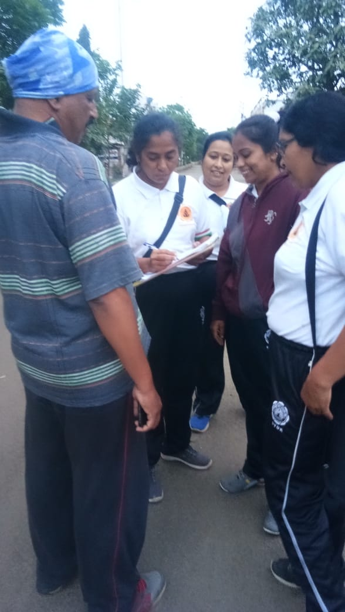
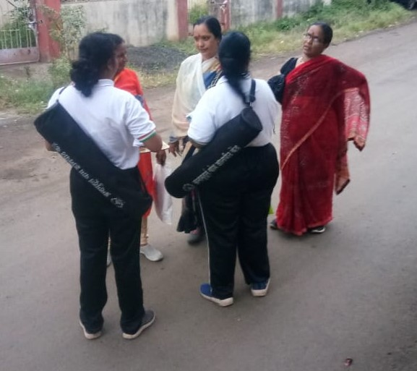
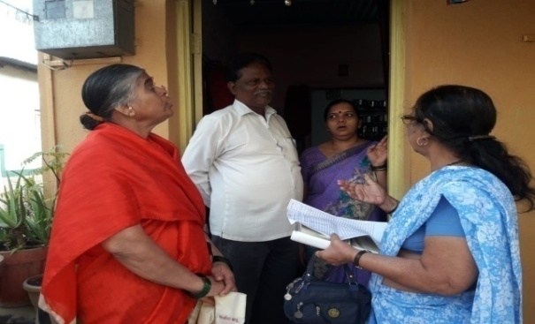
METHODOLOGY OF SHIBIR
To initiate the working of a new Shibir, pamphlets are distributed in the vicinity of the proposed shibir in nearby locality.
BYDK volunteers register details of the interested participants and then contact them a day or two prior to the Shibir.
BYDK Shibir is a 7 day FREE Workshop which transforms the life of the attendees in totality.
(Time: 4 am- 6 am)

Slide 6
Following are the activities conducted in the 7 day Shibir:
Music Meditation
Exercises
Various Yogasanas
Stick & Rope
Cardio
Bottle
c) Zumba Dance/ Aerobics
d) Spiritual discourse by Gurudev Deepakji
e) Different Sadhanas like Shaktikriya Sadhana, Wahe guru.
f) Demonstration of Power Surya Namaskar - which is the unique exercise exclusively developed by BYDK. By performing only 1 Power Surya Namaskar a person can burn away approximately 250 calories.

Slide 7
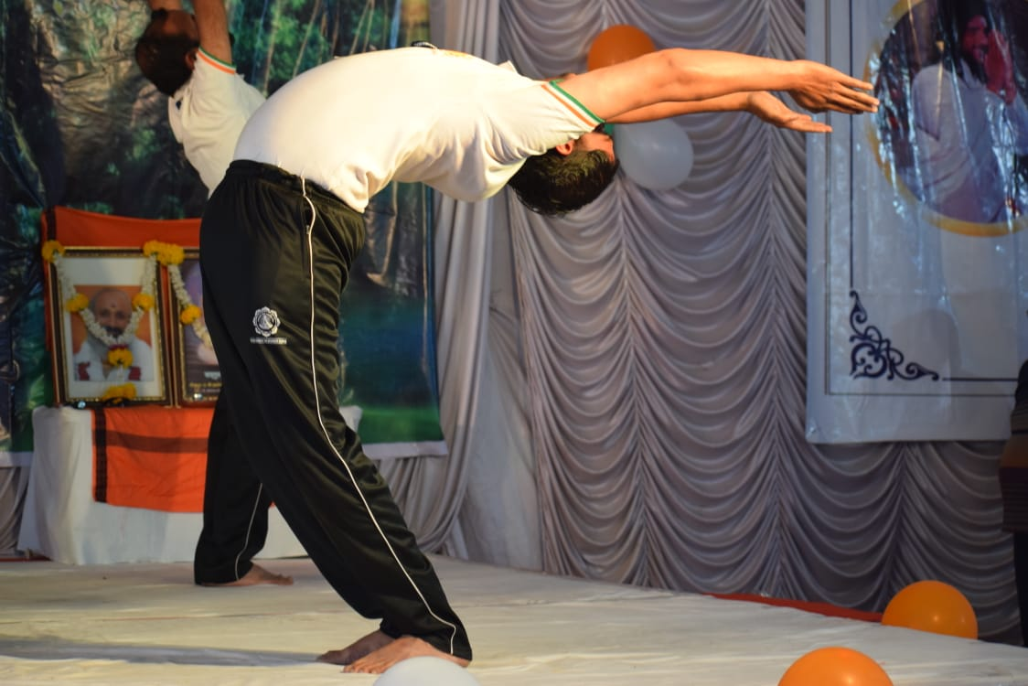
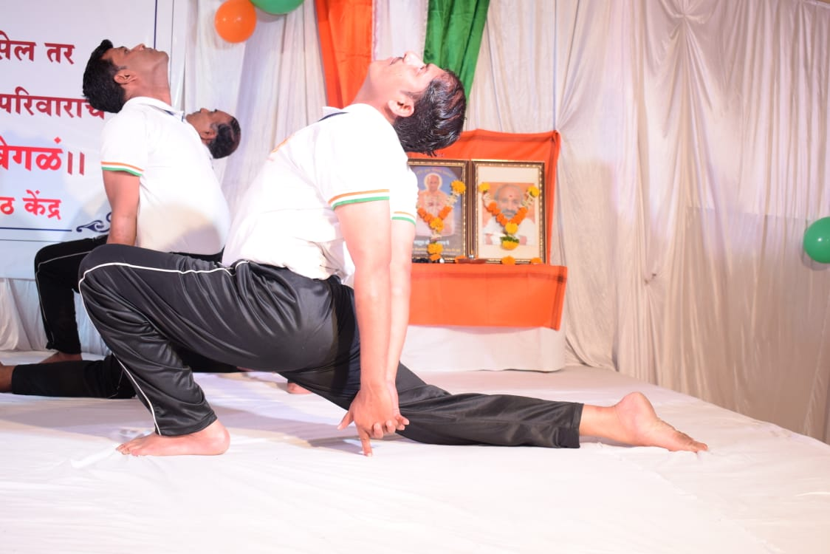
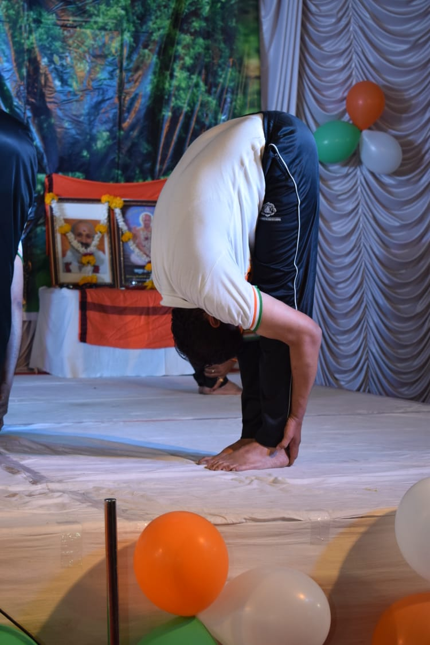
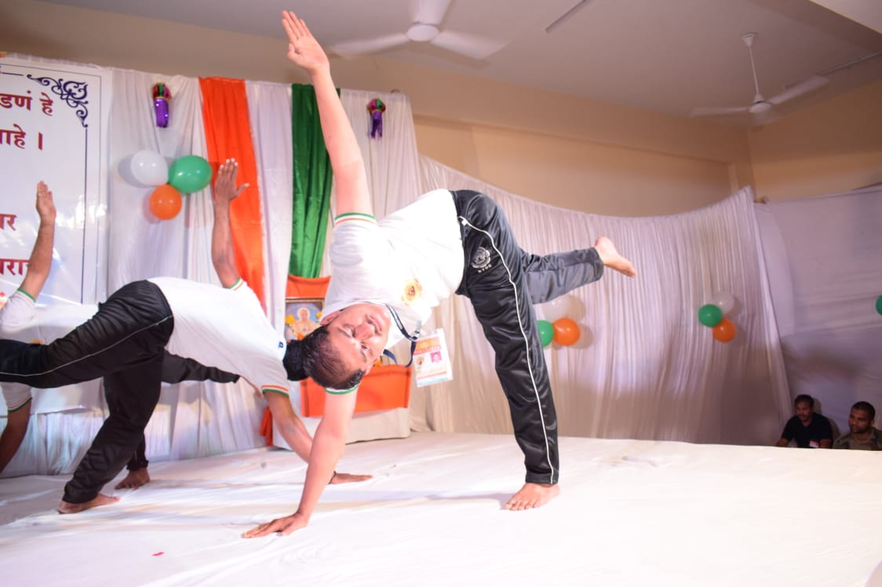
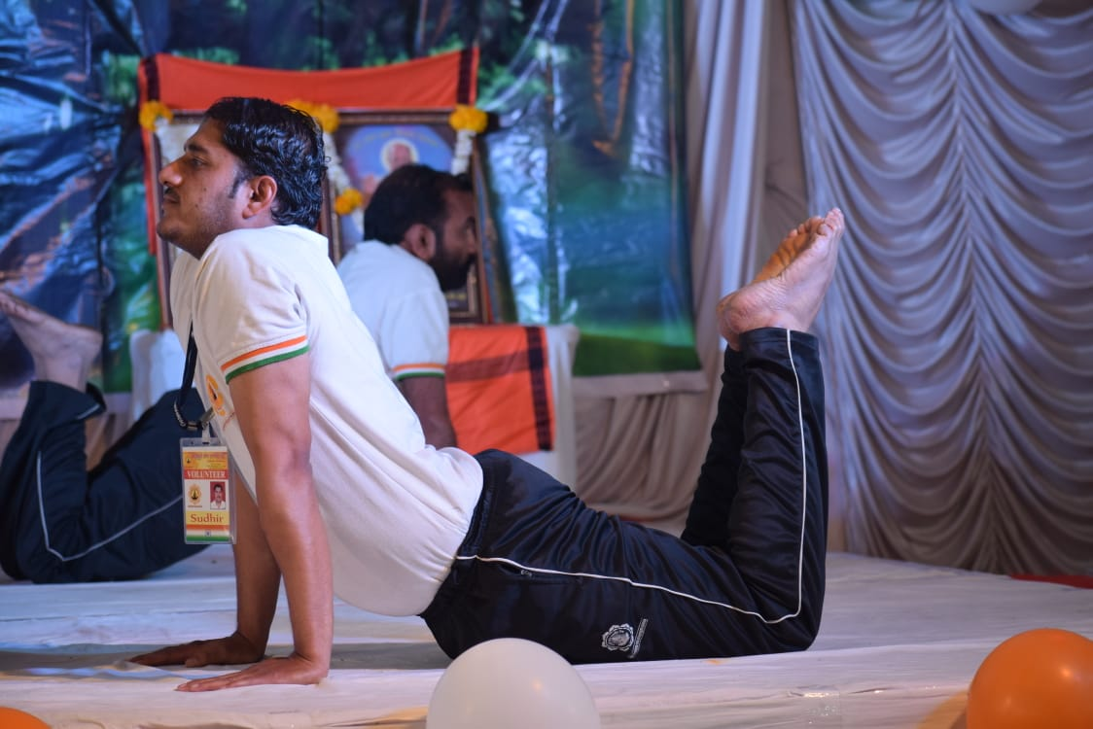
POWER SURYA NAMASKAR

Slide 8
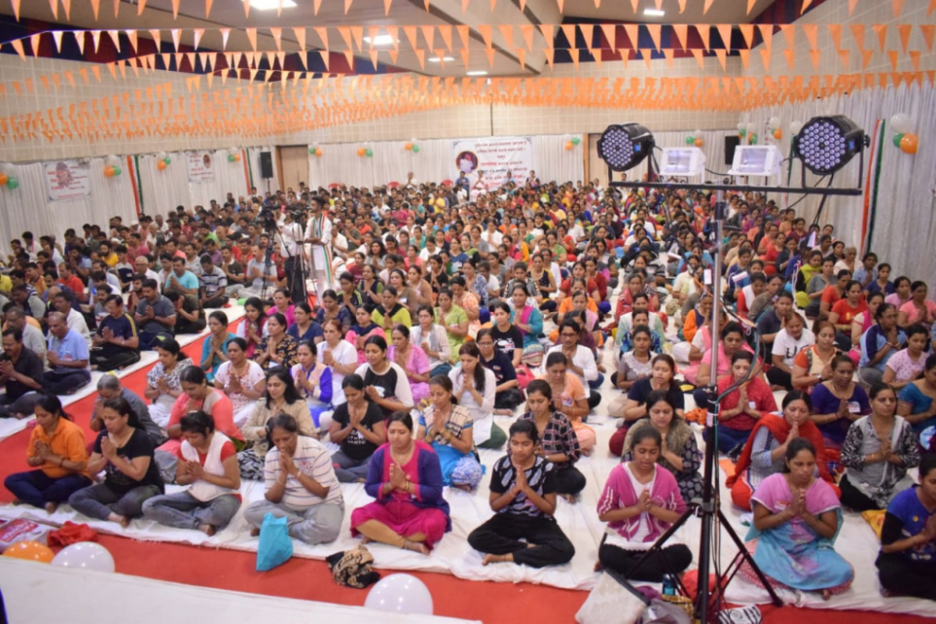
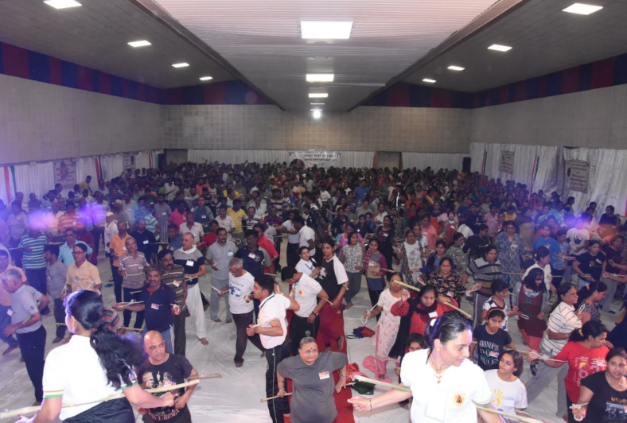
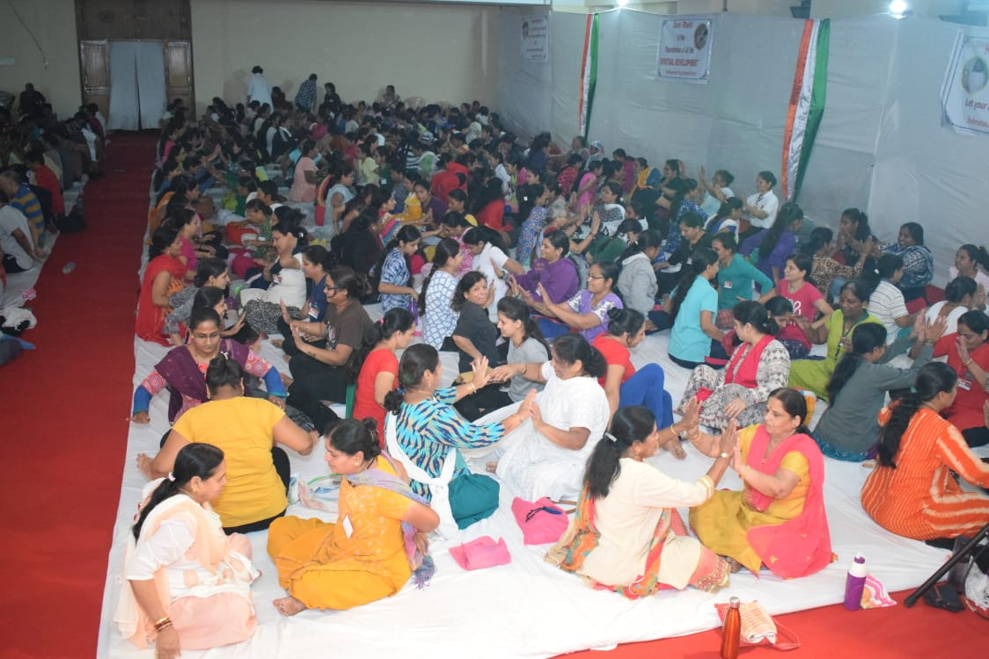
Music Meditation
Stick & Rope Exercise
Partner Exercise

Slide 9
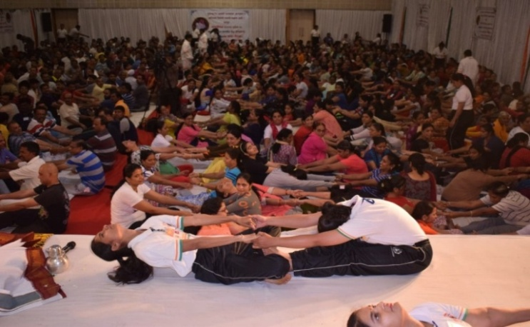
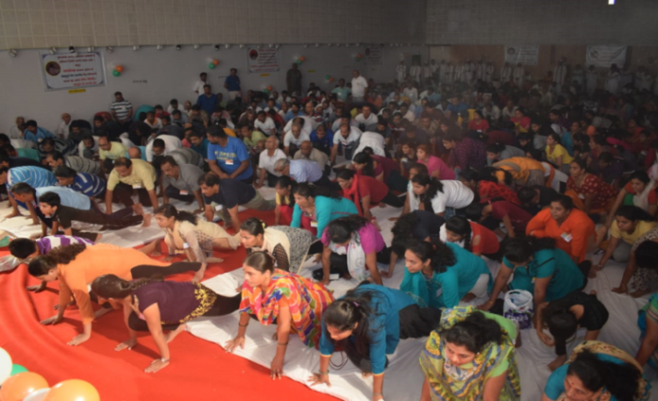
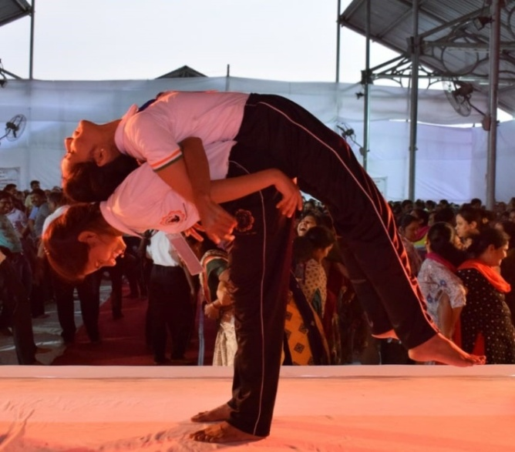
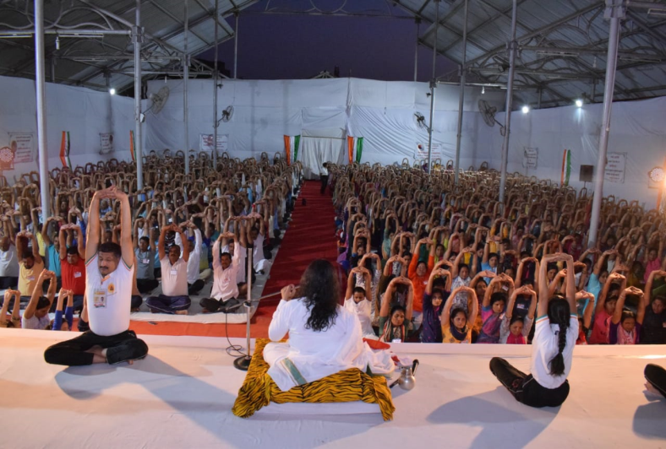
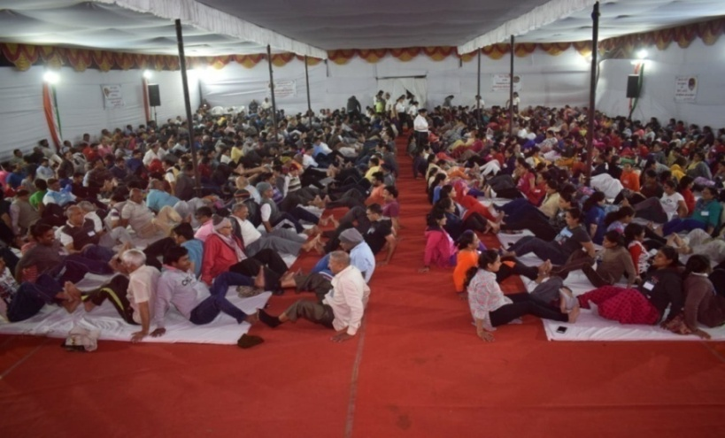
VARIOUS EXERCISES

Slide 10
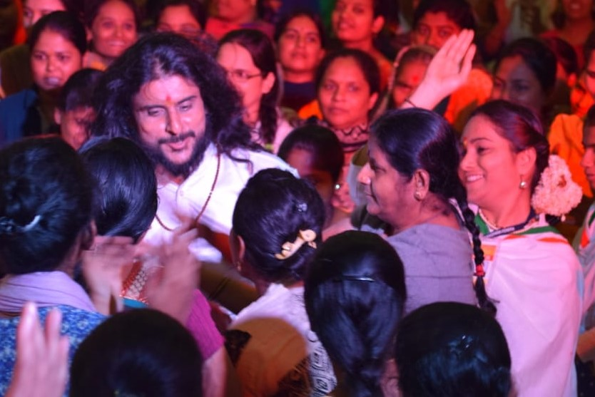
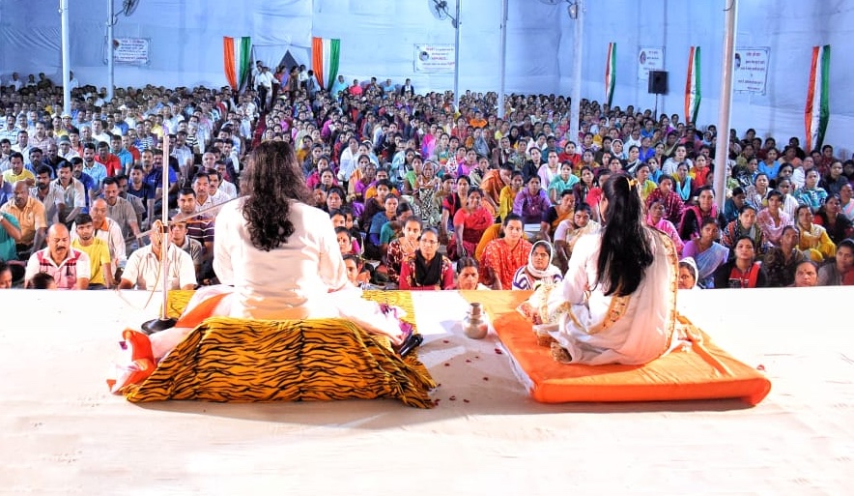
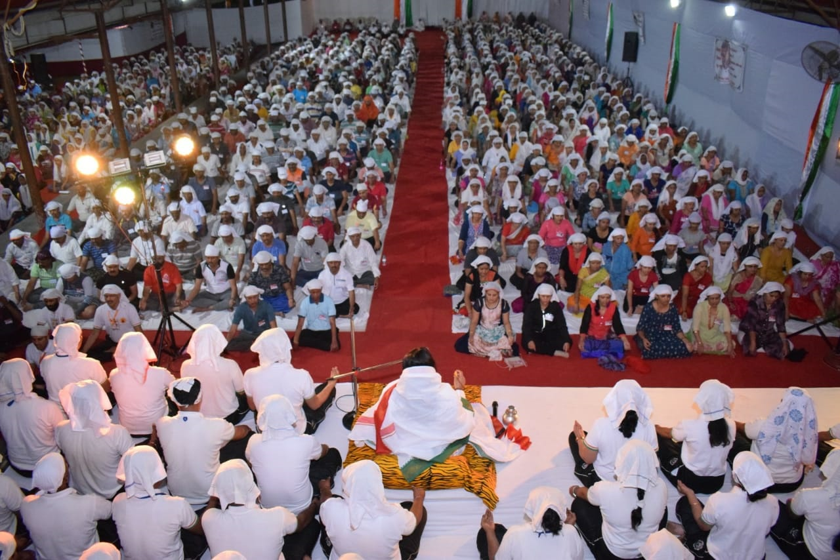
Dance with Gurudev
Spiritual Discourse by Gurudev & Gurumauli
Wahe Guru Sadhana- One of the main attractions of the shibir.

Slide 11
BYDK also conducts different activities like stick
& rope exercise, bottle exercise, clapping, zumba dance, etc. in the shibir and also in regular classes. Video links of the same are given below:
https://photos.app.goo.gl/EKsKKUyKF6K88ebK8 - Stick & Rope
https://photos.app.goo.gl/rmfQ3eEwAbo1TW3V9 - Bottle
https://drive.google.com/open?id=1kcBjvpwNxQ9TPtYkdfn_XmSC8UT74mPB – Radhe Radhe Dance (Cardio)
https://photos.app.goo.gl/WzbFHantpePuYP796 - Clapping
https://photos.app.goo.gl/2HfY4kHMkcpSfgDF7 - Yoga day

Slide 12
Wahe Guru Sadhana during Shibir:
https://drive.google.com/open?id=14IrV9EblpAyfr4Xu2TyFCgOt1mcAFQqn
https://drive.google.com/open?id=15bWM5ycvwlYE9j_1F4Gpbs2hCJElHYgy
https://drive.google.com/open?id=1Xr3pMdPKQ3fJBkrXngYoipYtU7o1EzIQ
Shaktikriya Sadhana:
https://drive.google.com/open?id=1h3vcL64tKhpCimHh-Hrm-1V-S5JKsYJu
https://drive.google.com/open?id=1xMbgIJ0twHB12iWmR6_2S2v1bQ9xQItE
https://drive.google.com/open?id=1gxO0k-wgBR5ju83U2ZzcMBj6pEHPTT8o
https://drive.google.com/open?id=1-FOZm4pMGQqDMLUJj0cMUZfJhw0PcfKp

Slide 13
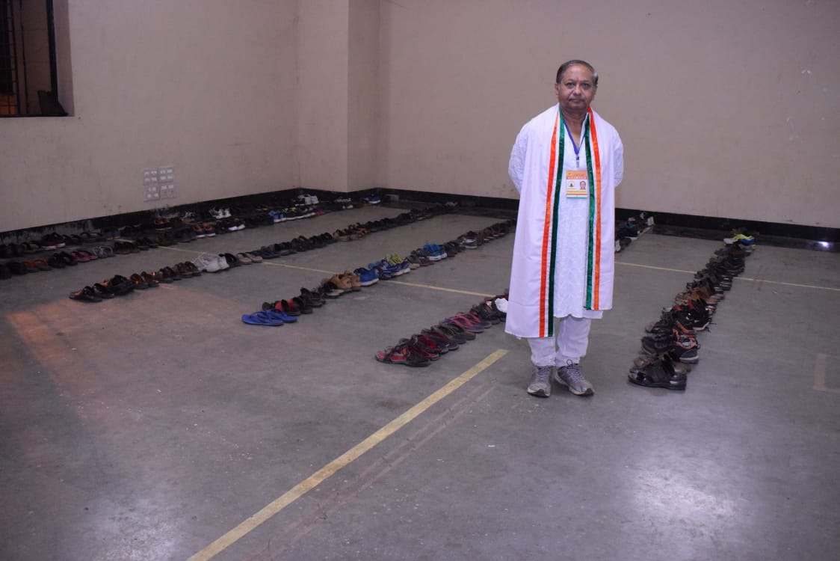
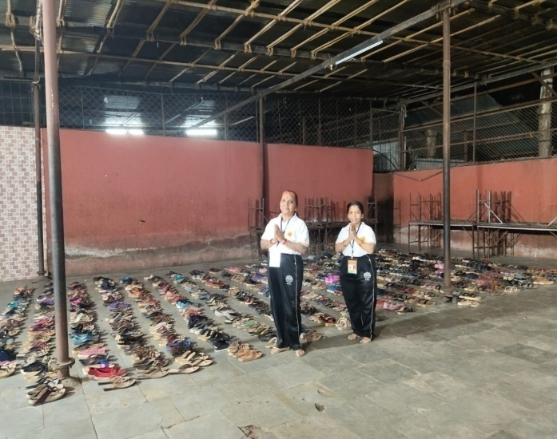
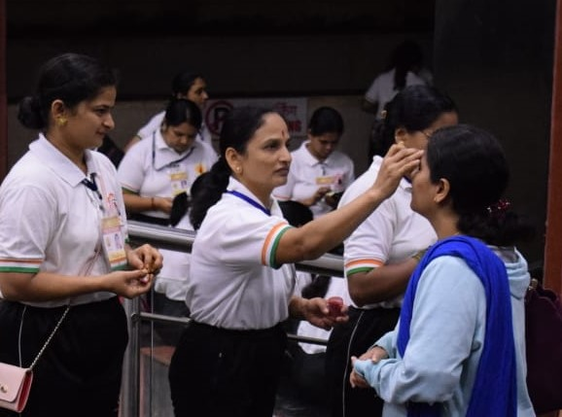
UNIQUENESS OF BYDK SHIBIR
Discipline at all stages right from entry to exit.
Welcome to all Participants by ‘Gandh’ & ‘Attar’ Seva.
Involvement of participants.
Free of cost (Zero Fees).

Slide 14
BYDK Shibir has achieved a huge fame & popularity in the masses, as the shibir leads to outstanding results:
Relief from Stress/tensions which is the root cause for all ailments.
Living life happily in the present.
Control over anger and anxiety.
Getting rid of laziness/ lethargy.
Improvement in spoilt relations within the family.
New enhanced Lifestyle.
Improvement in Mental & Physical Health.

Slide 15
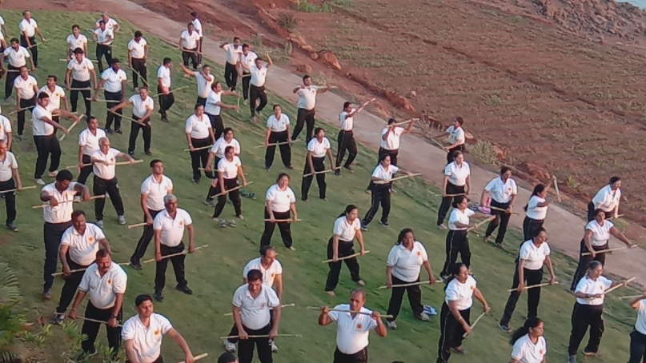
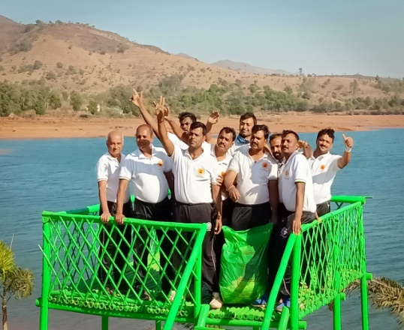
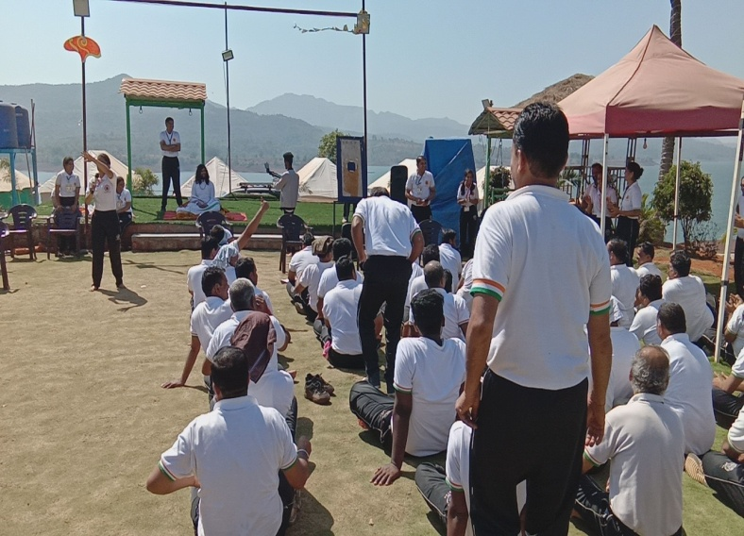
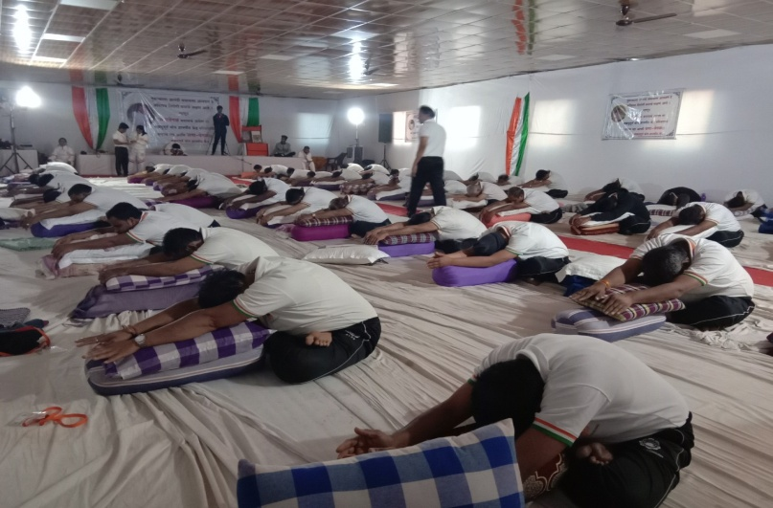
Apart from the regular shibirs BYDK also
conducts following shibirs:
3 Day Residential Course

Slide 16
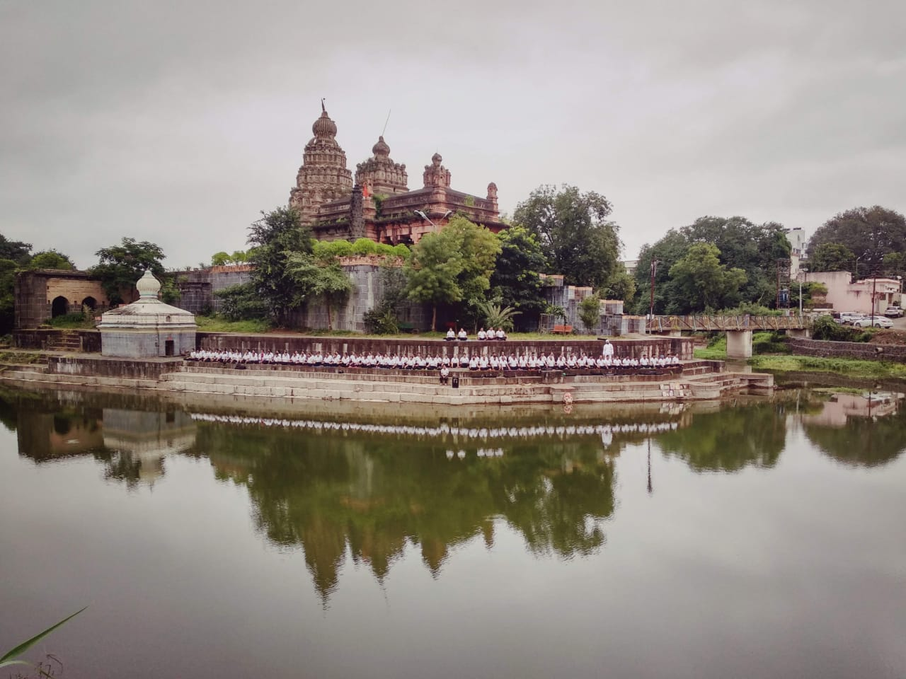
Divyabodhana Sadhana
https://drive.google.com/open?id=1YmIyothxKo5R0SrOzSUaymIOkGxlHeEv
Saswad Meditation
https://youtu.be/NUq_Hm10VzY-

Slide 17
BYDK holds special programs to celebrate the following occasions:
Annual Day (BYDK).
Independence Day/ Republic Day.
Tree Plantations.
Medical Check-up Camp.
Warkari Seva Camp.
International Yoga Day.
Gurupoornima.
Sakal Press Shibir.

Slide 18
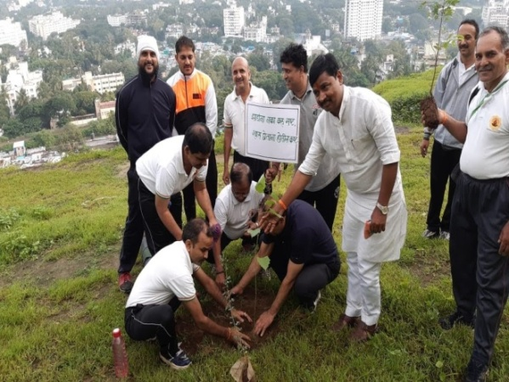
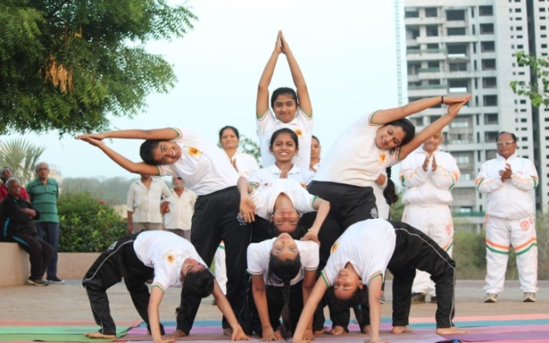
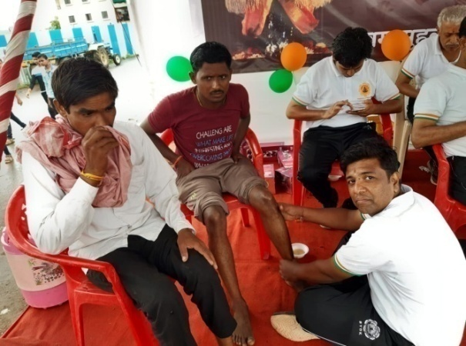
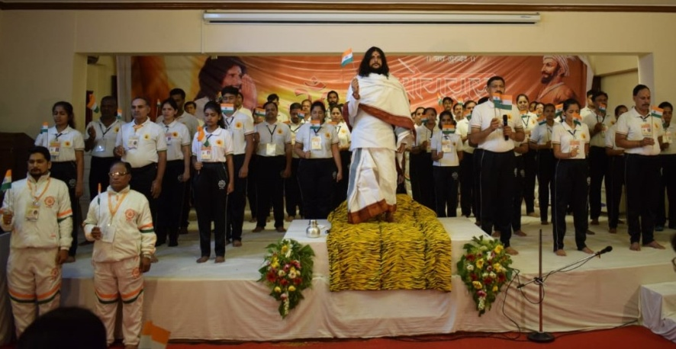
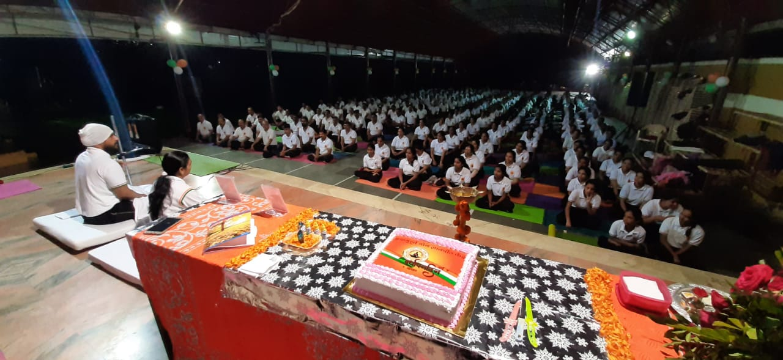
DIFFERENT SOCIAL ACTIVITIES OF BYDK
Tree Plantation
International Yoga Day
Warkari Seva Camp
Independence Day
Annual Day

Slide 19
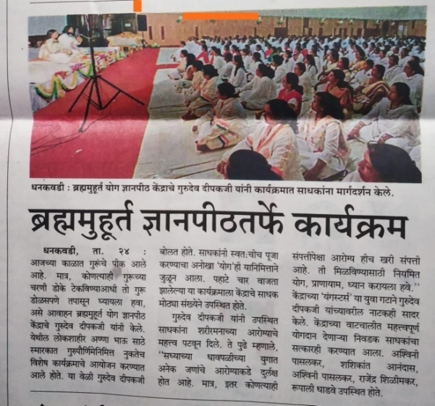
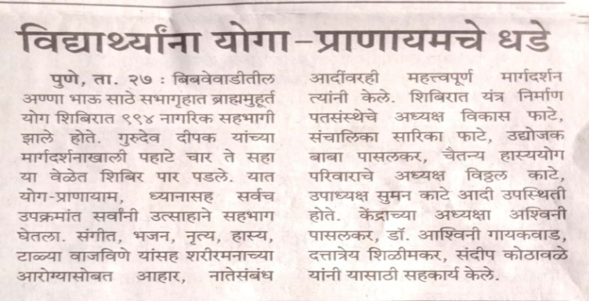
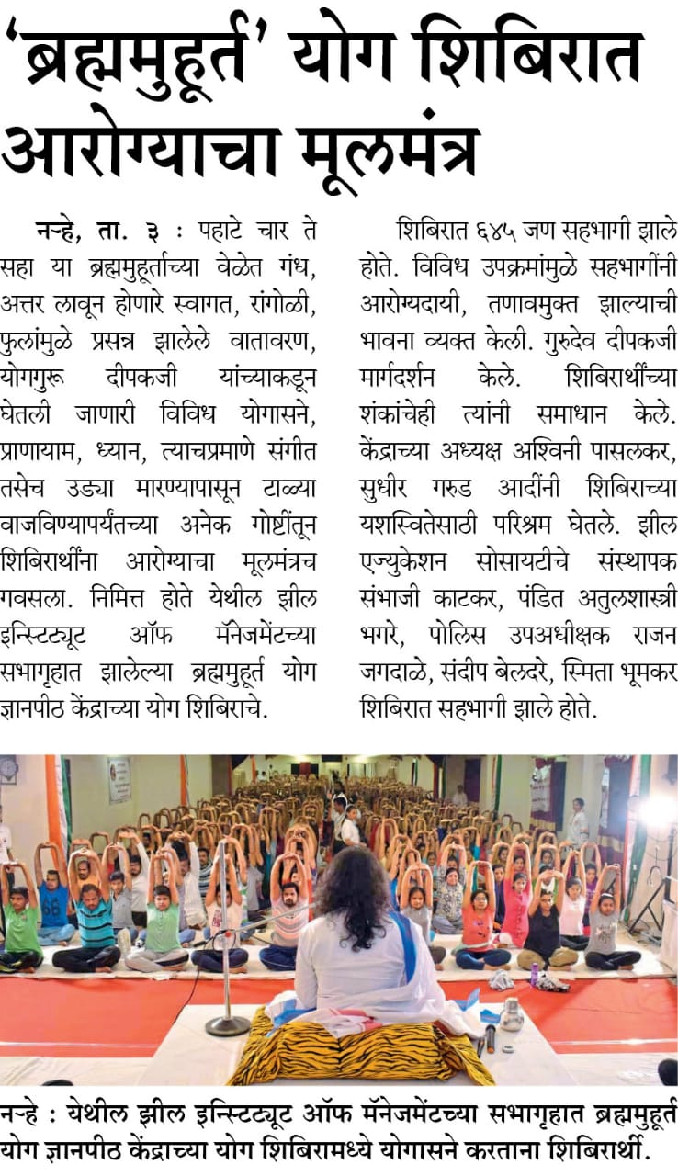
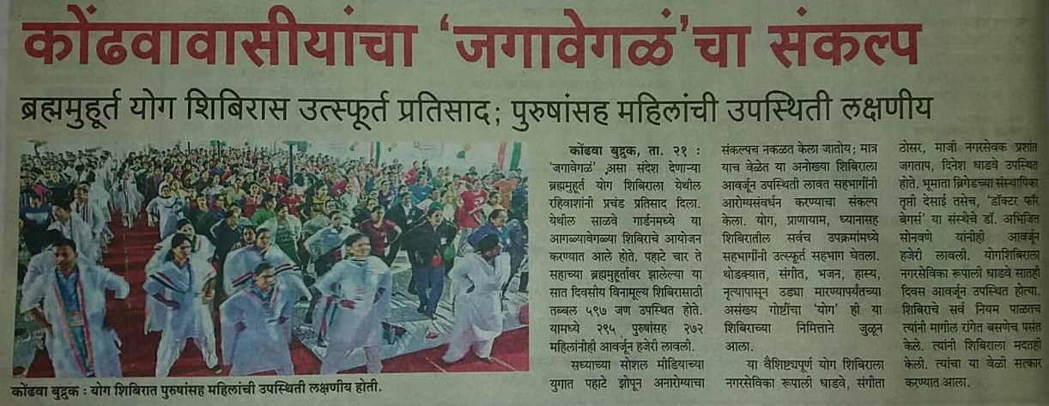
BYDK ACTIVITIES RECOGNIZED
BY THE MEDIA

Slide 20
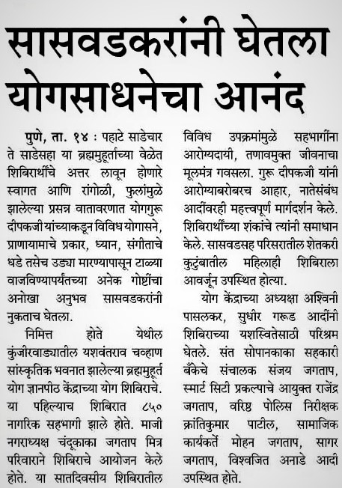
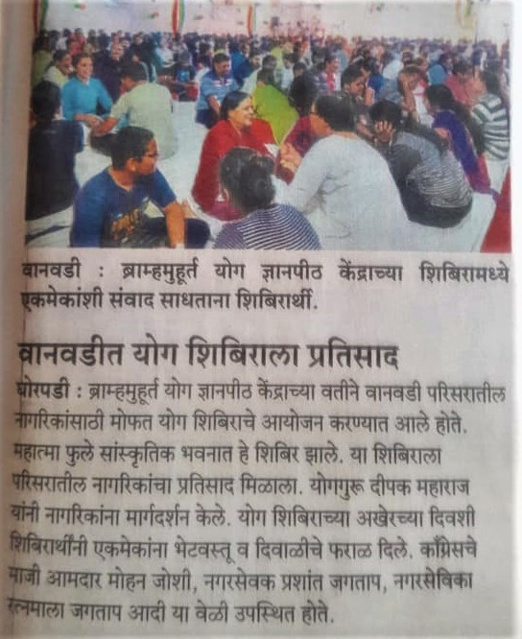
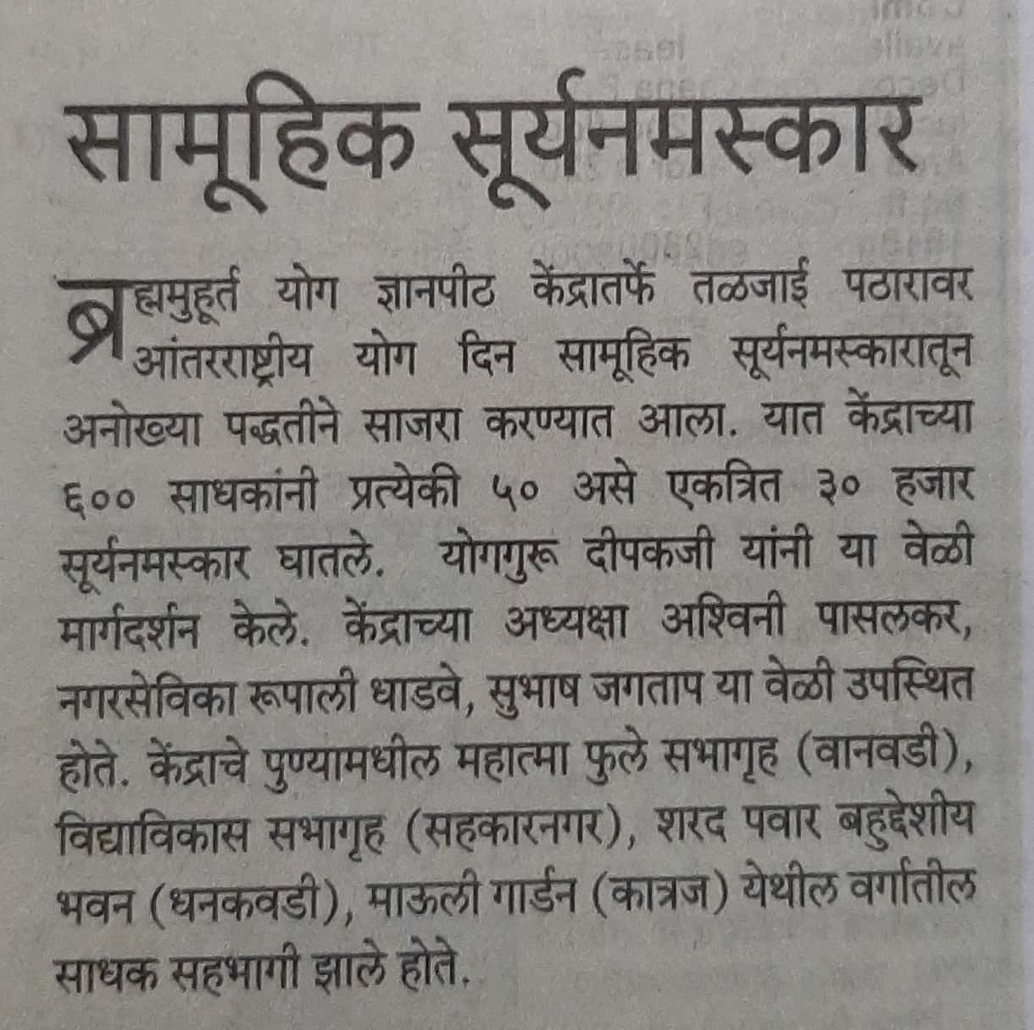

Slide 21
RESULTS OF BYDK REGULAR CLASS
https://drive.google.com/file/d/11kMS_NXjoou6zeAhEXNMpBcpyAo0JkLh/view?usp=sharing
https://drive.google.com/open?id=1Cjvjqu8hu6oLPa7Kt4eSDSq5xvTmOn_Z
https://drive.google.com/open?id=1qWoM0nJ3loxbZx4YLyRDlrvjTrsK9dja
https://drive.google.com/open?id=1q1vyuvAcSaoLCAv0ulthGwnua0_G54LX
https://drive.google.com/open?id=18t3Kg4AXCgDnjhV2E-OyPRLYmDBm6g4G
https://drive.google.com/open?id=1V1aWa94R3YR7MSmnF9LN2l3WvHe1QZo6

Slide 22
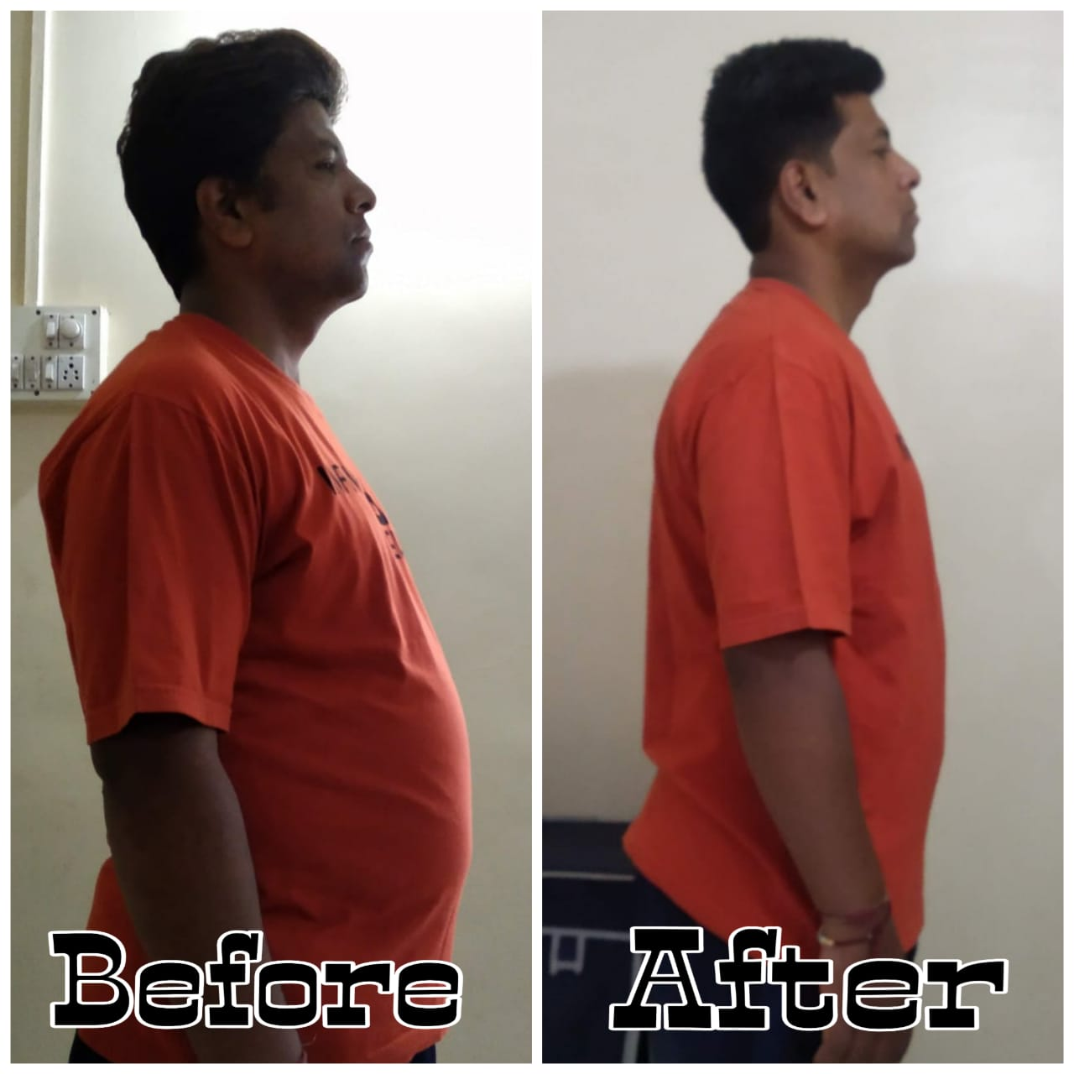
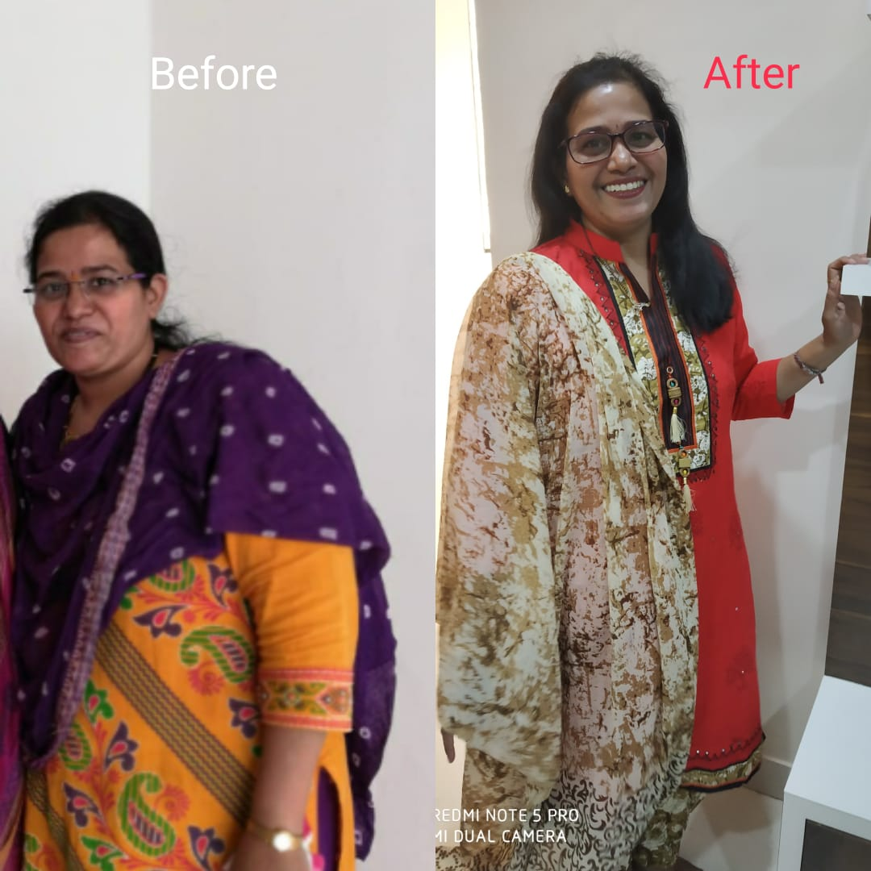
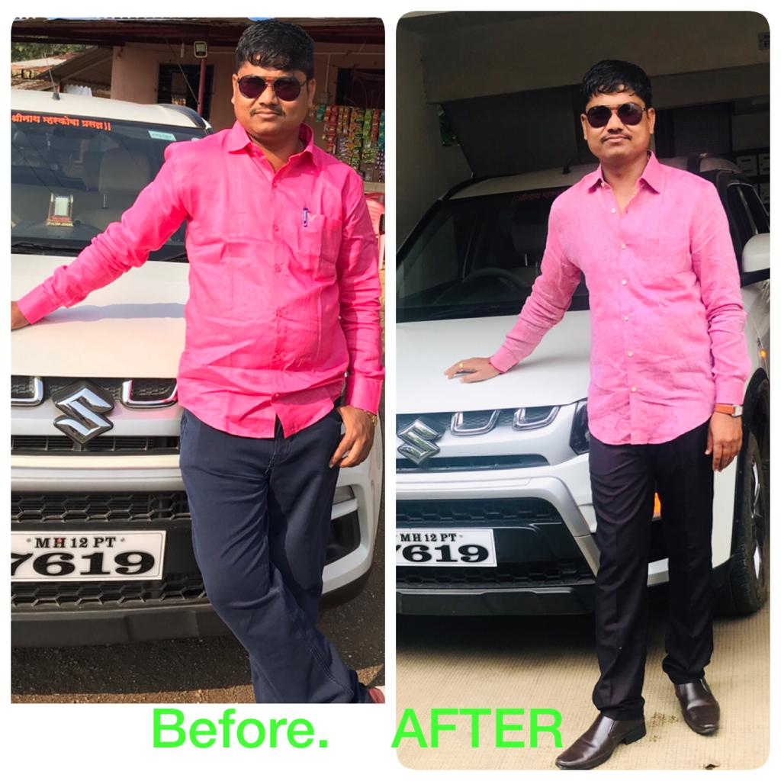
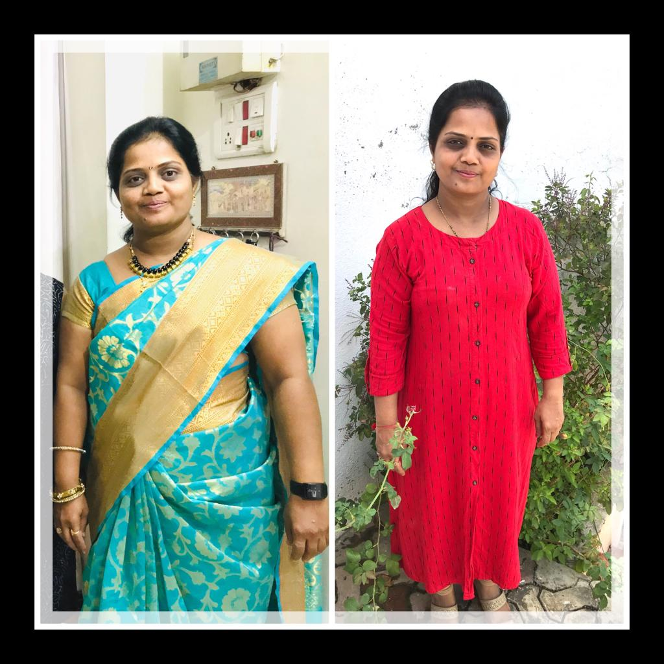
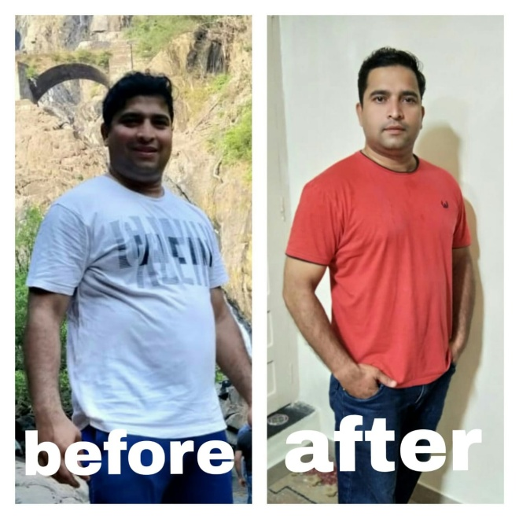
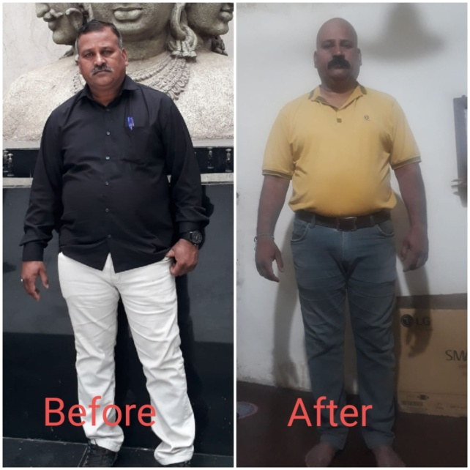

Slide 23
FEEDBACK BY THE SHIBIR SADHAKS
https://drive.google.com/open?id=1YkU3qfum7NSARjGBFX3yTzyTWnY80psp
https://drive.google.com/open?id=1Dn_T3lTpZ7Sx040qfDJLNaWHLqiTKS3w
https://drive.google.com/open?id=1G-6rZK2DtKqC3GiiX1JBtJeMCgPYZSTZ
https://drive.google.com/open?id=1pi1eqY0GN_3M0Ssn2mrlJH9HEWZqt9kv
https://drive.google.com/open?id=13BLYdq9bwUlE3xabvNGE2HLxsleNvQ2y
https://drive.google.com/open?id=1mmJFNyI63wPQNpCUqUiMZZknibYqoZUM

Slide 24
BYDK always gave outstanding results which
benefitted not only the normal people but also to the physically abnormal ones. After a 7 Day shibir people felt satisfied and fresh physically as well as mentally.
https://drive.google.com/open?id=1gFqYd3VHQgX_fe0RAkcJiiukCALEyOyf
Also, the regular batch Sadhaks and their relatives felt the positivity of the BYDK and Deepakji.
https://drive.google.com/open?id=1GmoeB8ymXZDBrlv3VR8R-yjvu4sNLYJG

Slide 25
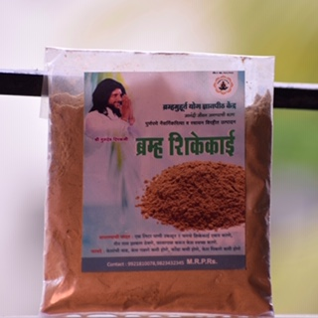
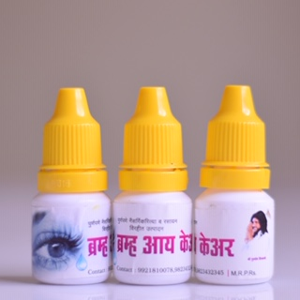
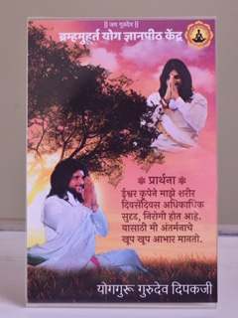
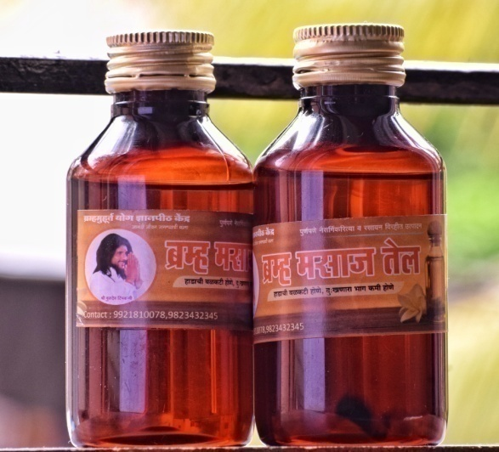
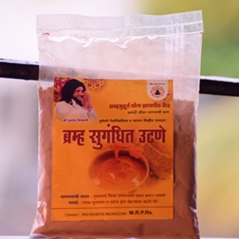
BRAMHA PRODUCTS
Bramha Shikakai
Bramha Eye Care
Bramha Aarogya Prarthana Frame
Bramha Massage Oil
Bramha Sugandhit Utane

Slide 26






Bramha Shatavari Kalp
Bramha Kesh Tel (Hair oil)
Bramha Bhegantika Cream (Foot Cream)
Bramha Gul
(Jaggery)
Bramha Gulkand
Bramha Ashtagandh

Slide 27




Gurudev Deepakji receiving various Awards

Slide 28
WAY FORWARD
BYDK proposes to further conduct 20 shibirs in the BYDK Year September 2019- August 2020 which will cover around 20,000 Sadhaks.
BYDK also plans to conduct below mentioned courses which are conducted once in a year.
Residential Course – 1 Batch
Divyabodha Sadhana – 1 batch

Slide 29
TEAM CREDENTIALS & CONTACT
Sr. No. | Name | Contact No. | Post
1. | Mr. Deepak. Shilimkar. | --- | Founder
2. | Mrs. Vaishali. Shilimkar. | --- | Co-founder
3. | Mrs. Ashwini. Pasalkar. | 9604166142 | President
4. | Mr. Shashikant. Anandas. | 9657056730 | President
5. | Mr. Sudhir. Garud. | 9823432345 | Member
6. | Mrs. Mamta. Chordiya | 7020357550 | Member
7. | Mrs. Aarti. Kadam. | 9822927096 | Member
For further details and queries please mail us:
bydkpune@gmail.com

Slide 30

TEAM MEMBERS

Slide 31
THANK YOU

